Slide 1
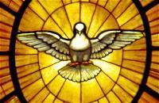
Memory Work, Unit 21
CCM-Schola Rosa Edition

Slide 2
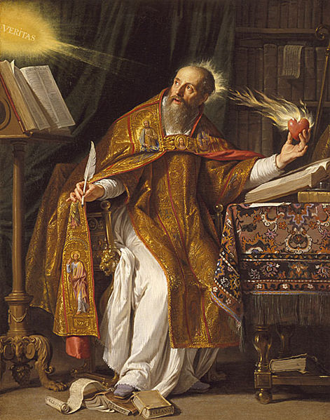
Religion
Q: Can we know God in any other way than by our natural reason?
A: Besides knowing God by our natural reason, we can also know Him from supernatural revelation, that is, from the truths found in Sacred Scripture and in Tradition, which God Himself has revealed to us.

Slide 3
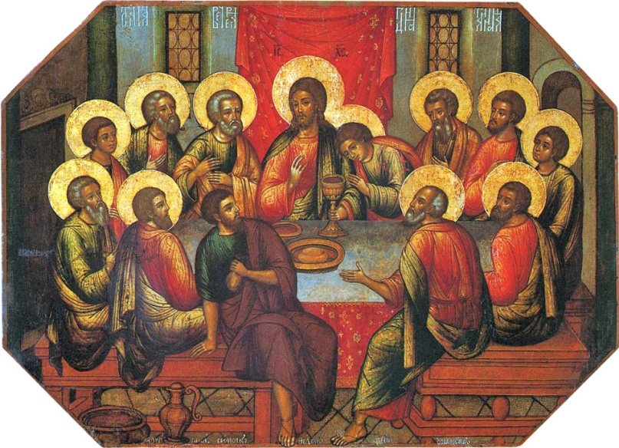
Scripture
Psalm 16:1-4: Preserve me, O God, for in thee I take refuge. I say to the Lord, “Thou art my Lord; I have no good apart from thee.” As for the saints in the land, they are the noble, in whom is all my delight. Those who choose another god multiply their sorrows; their libations of blood I will not pour out or take their names upon my lips.

Slide 4
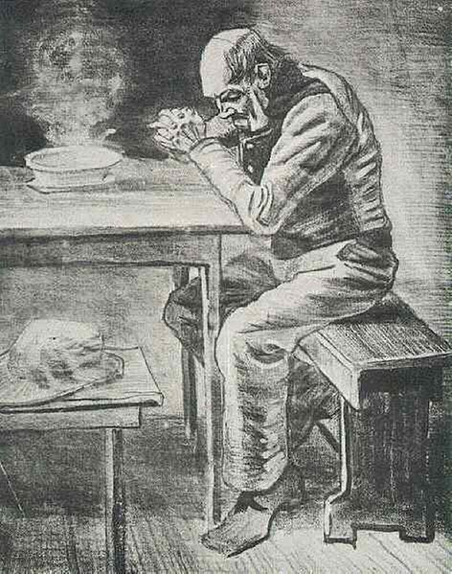
Latin
per Christum Dominum nostrum. Amen.

Slide 5
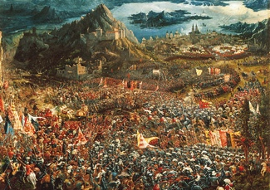
History
The Greeks fought against the great kingdom of Persia between 500 B.C. and 450 B.C. Two great Persian kings from this time were King Darius and King Xerxes. Famous battles included Marathon and Salamis, and the Greeks finally won.

Slide 6
Science
Q: What are the major characteristics of the class insects? A: Insects have an exoskeleton, six jointed legs, a three-part segmented body, compound eyes, and two antennae.
Q: What are the stages of complete metamorphosis in insects?
A: Egg, Larva, Pupa, Adult

Slide 7
Math
The perimeter of a polygon =
The sum of the length of its sides

Slide 8
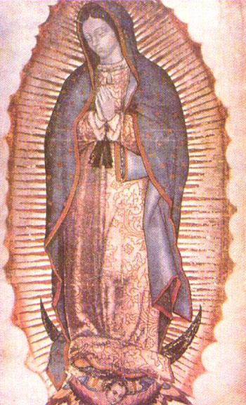
Timeline
Cortes Conquers Mexico
Our Lady of Guadalupe
Saint Teresa of Avila
Czars in Russia
Cabot, Cartier, and Champlain Explore Canada
The Ottoman Empire and the Battle of Lepanto
Founding of Jamestown: 1607
Hudson Explores the Northeast

Slide 9
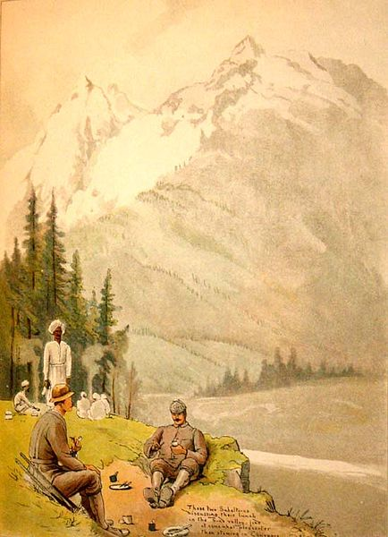
Geography
Afghanistan
Pakistan
Indus River
India
Nepal
Himalayas
Mount Everest

Slide 10
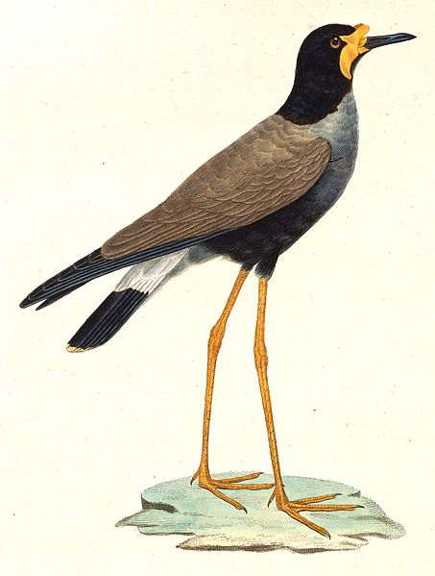
Great Words I
“O lapwing thou fliest around the heath” By William Blake
O lapwing thou fliest around the heath Nor seest the net that is spread beneath; Why dost thou not fly among the corn fields? They cannot spread nets where a harvest yields.

Slide 11
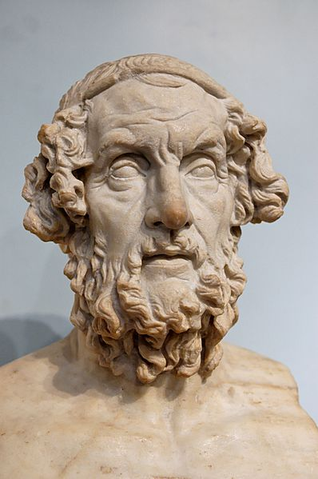
Great Words II
“The Odyssey, Book 1, verses 1-19” by Homer
Begin the tale somewhere for us also, goddess, daughter of Zeus. Then all the others, as many as escaped sheer destruction, Were at home, having fled both the war and the sea. Yet he alone, long for his wife and for a return,
Was held back in a hollowed cave by the queenly nymph Calypso, The divine goddess, who was eager for him to be her husband.

