Slide 1
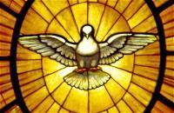
Memory Work, Unit 20
CCM-Schola Rosa Edition

Slide 2
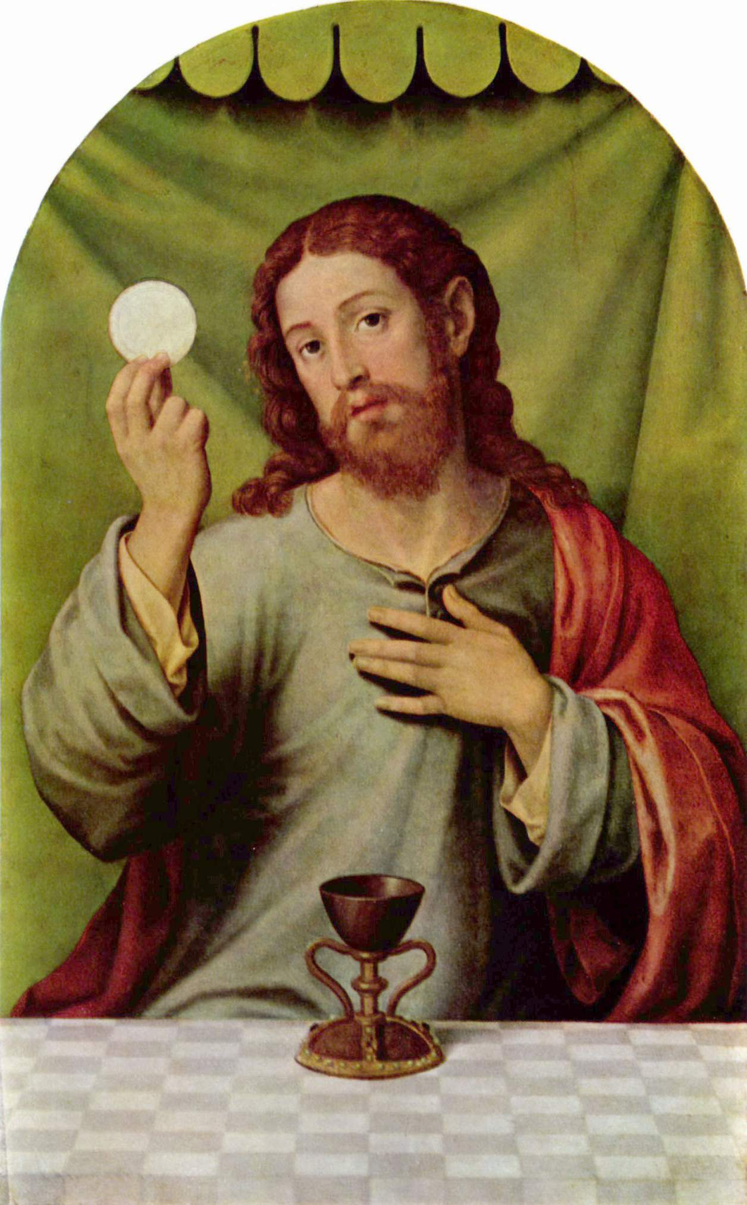
Religion
Q: How do priests exercise their power to change bread and wine into the body and blood of Christ?
A: Priests exercise their power to change bread and wine into the body and blood of Christ by repeating at the Consecration of the Mass the words of Christ: “This is My Body … this is My Blood.”

Slide 3
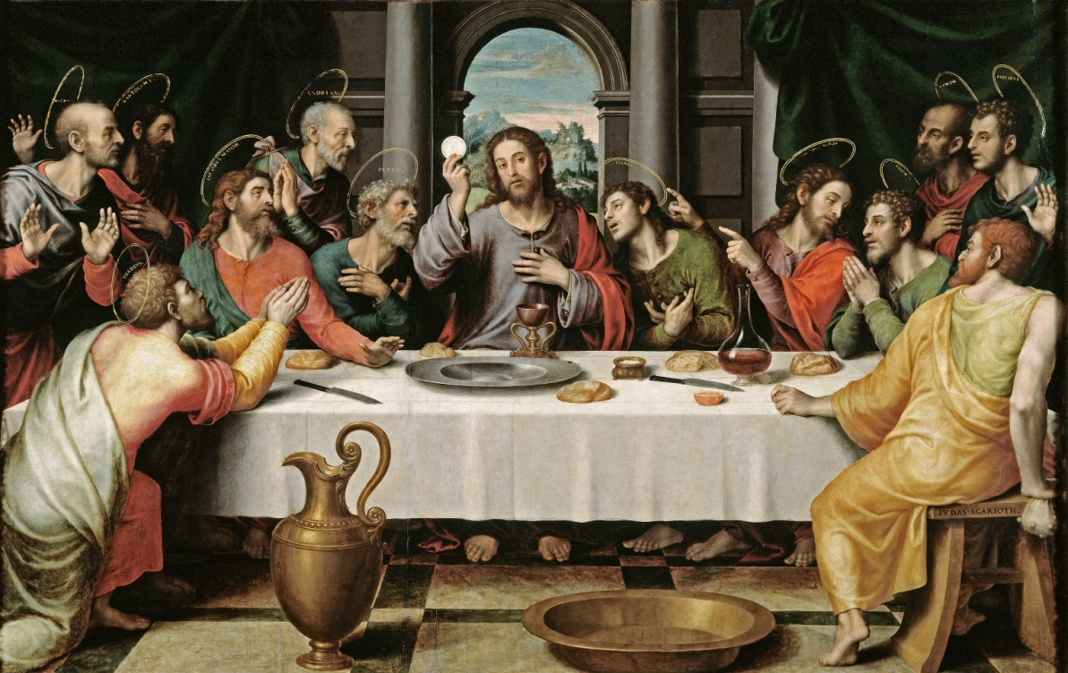
Scripture
John 6: 53-54
“Amen, Amen, I say to you, unless you eat the flesh of the Son of man and drink his blood, you have no life in you; he who eats my flesh and drinks my blood has eternal life, and I will raise him up at the last day.”

Slide 4
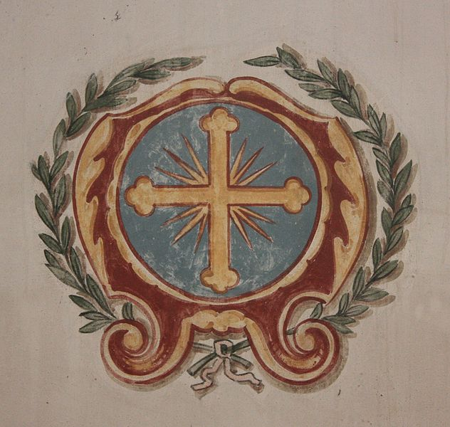
Latin
Ut cum Sanctis tuis laudem te,
In saecula saeculorum.
Amen.

Slide 5
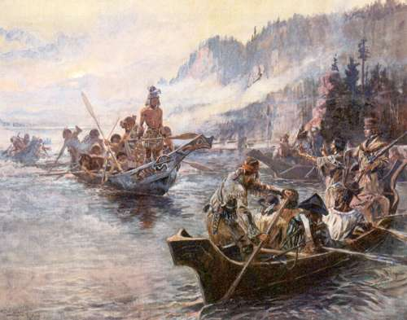
History
The first three presidents of the United States were George Washington, John Adams, and Thomas Jefferson. In 1803, Jefferson purchased Louisiana from France, doubling the size of the United States. Lewis and Clark began exploring and mapping the new territory in 1804 and returned in 1806.

Slide 6
Science
Q: What are two kinds of electricity?
A: Static and Current

Slide 7
Math
The volume of a rectangular solid
= Its length times its width times
Its height

Slide 8
Timeline
Ottoman Turks Capture Constantinople: 1453
Gutenberg and the Printing Press
The Renaissance
Muslims Driven out of Spain
Columbus Discovers America: 1492
Martin Luther and the Reformation
The Council of Trent
Da Gama and Magellan Sail
1453
1492

Slide 9
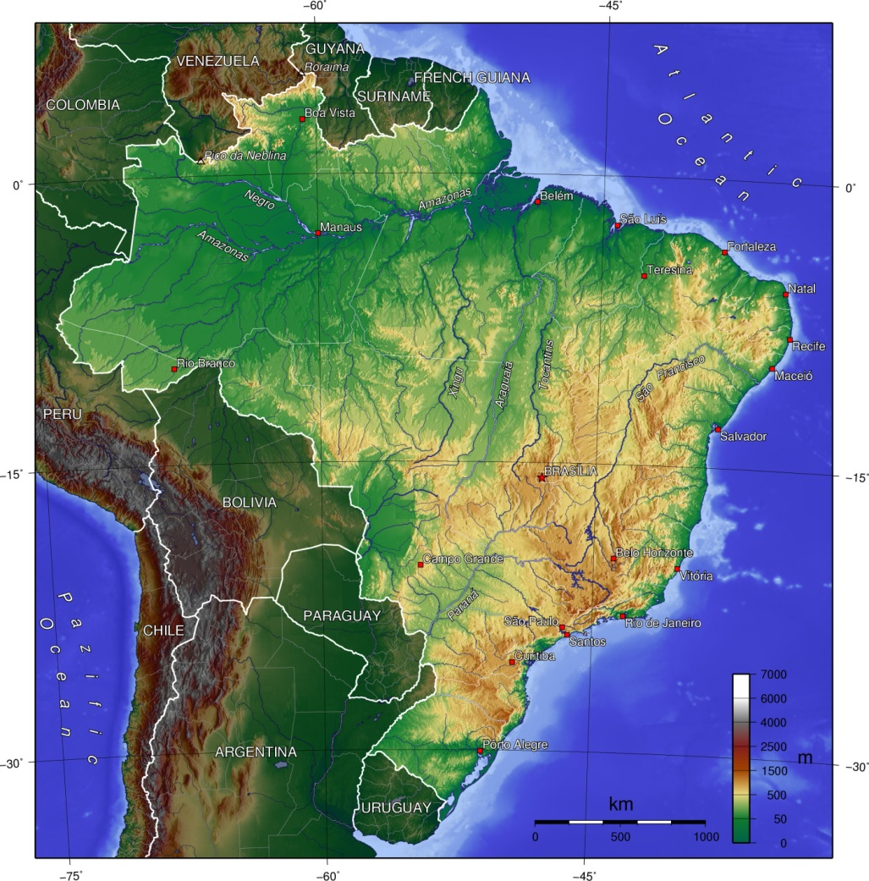
Geography
Brazil
Amazon River
Purus River
Madeira River
Tocantins River
Sao Francisco River

Slide 10
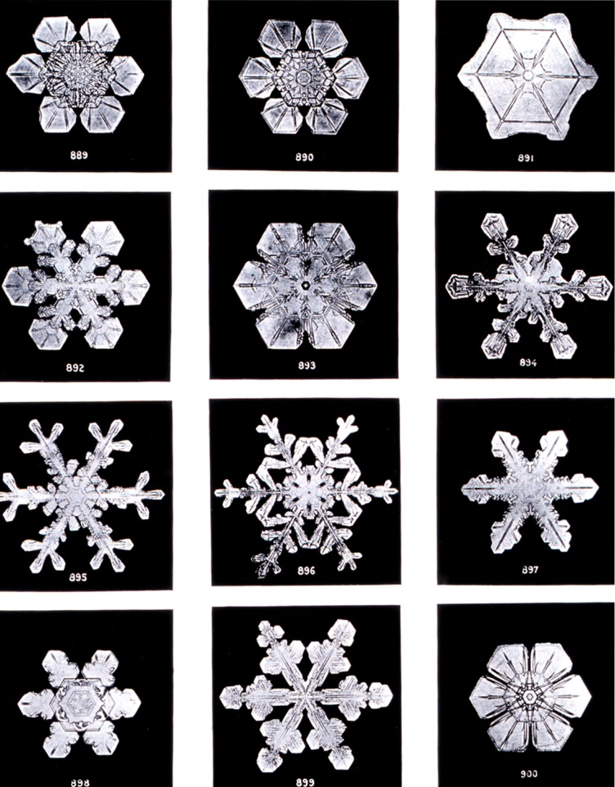
Great Words I
My little horse must think it queer,
To stop without a farmhouse near,
Between the woods and frozen lake,
The darkest evening of the year.

Slide 11
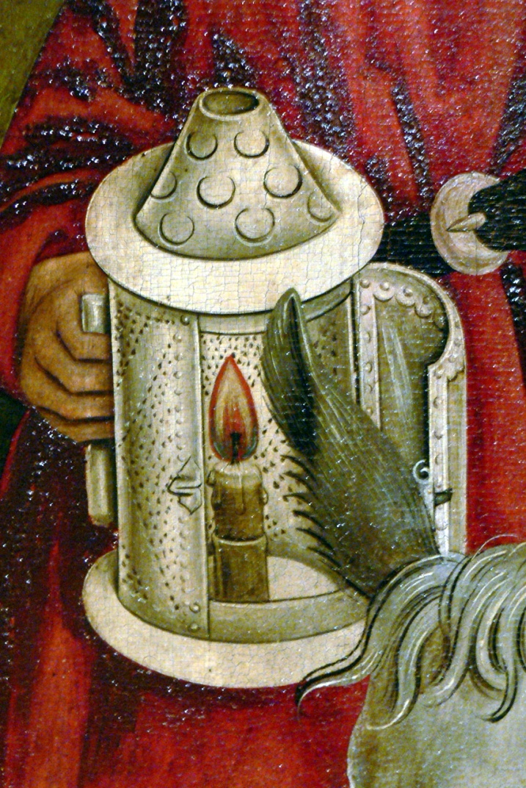
Great Words II
I was not ever thus, nor prayed that Thou Shouldst lead me on.
I loved to choose and see my path; but now Lead Thou me on!
I loved the garnish day, and spite of fears,
Pride ruled my will; remember not past years.

